Slide 1
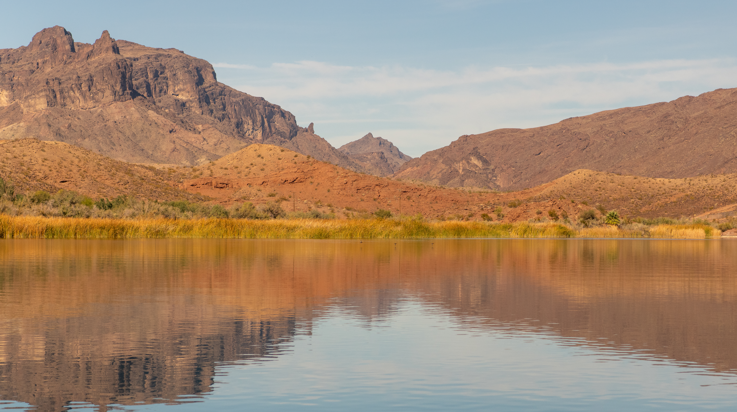

One Water – Actions to Take Today
to Ensure Water Reliability Tomorrow
May 25, 2022

Slide 2
Southern California Water Dialogue
Co-chairs
CONNER EVERTS
Executive Director
Southern California Watershed Alliance
DEE ZINKE
Assistant General Manager/Chief External Affairs Officer, External Affairs
The Metropolitan Water District of Southern California

Slide 3
Southern California Water Dialogue
Steering Committee
E.J. CALDWELL West Basin Municipal Water District
RITA KAMPALATH LA County Chief Sustainability Office
ZITA YU Jacobs
FERNANDO PALUDI Trabuco Canyon Water District
PEER SWAN Irvine Ranch Water District
CHARMING EVELYN Sierra Club
CHARLEY WILSON Southern California Water Coalition
MARTHA CAMACHO RODRIQUEZ Central Basin Municipal Water District
MARK STADLER SDCWA, (Retired)
RICH ATWATER Foothill Municipal Water District
FRED O’CALLAGHAN JPL/NASA (Retired)
KATHY CALDWELL So Cal Water Dialogue, Coordinator

Slide 4

Webinar Ground Rules
Technical Difficulties: Use chat feature to let us know
Asking a Question: Use Q/A feature, type in question, and click send. Questions addressed after presentation.
Poor Connection: Move closer to your wireless router and turn off other services using bandwidth (e.g. Netflix)
Audio Muted: Attendee audio on mute by default
Timetable: Presentation runs apx 60 minutes followed by Q/A session
Notes:
Apx.

Slide 5
How to Ask A Question
On the bottom of your screen, click “Q&A”

Slide 6


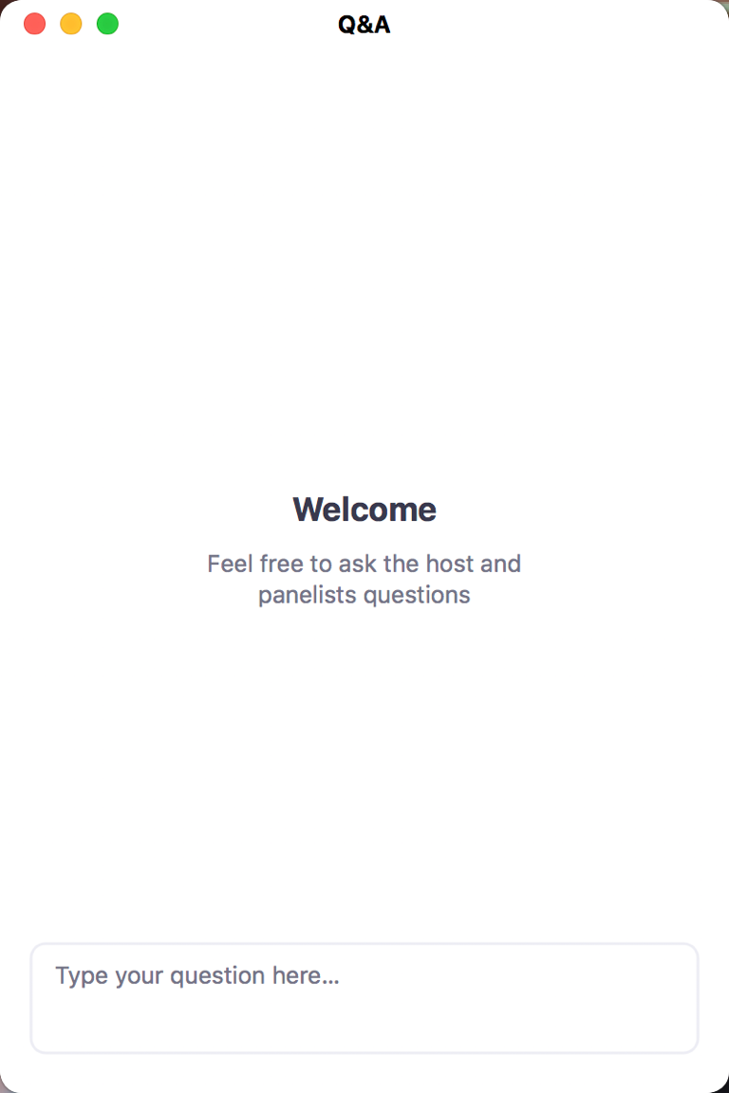
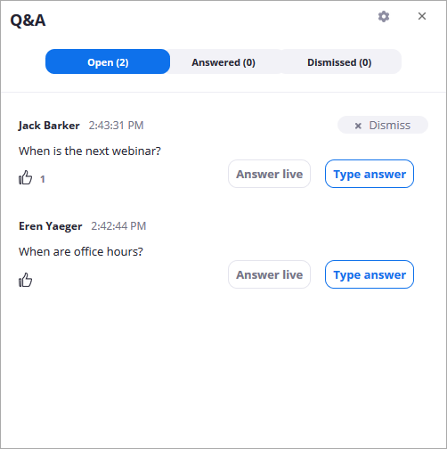
You can upvote by clicking
“thumbs up” icon
Type in question and
then click send

Slide 7
Agenda
Announcements and Introduction of Speaker
Topic overview – by Conner Everts
Discussion
Dialogue (Q/A) – Led by Dee Zinke
Concluding remarks

Slide 8
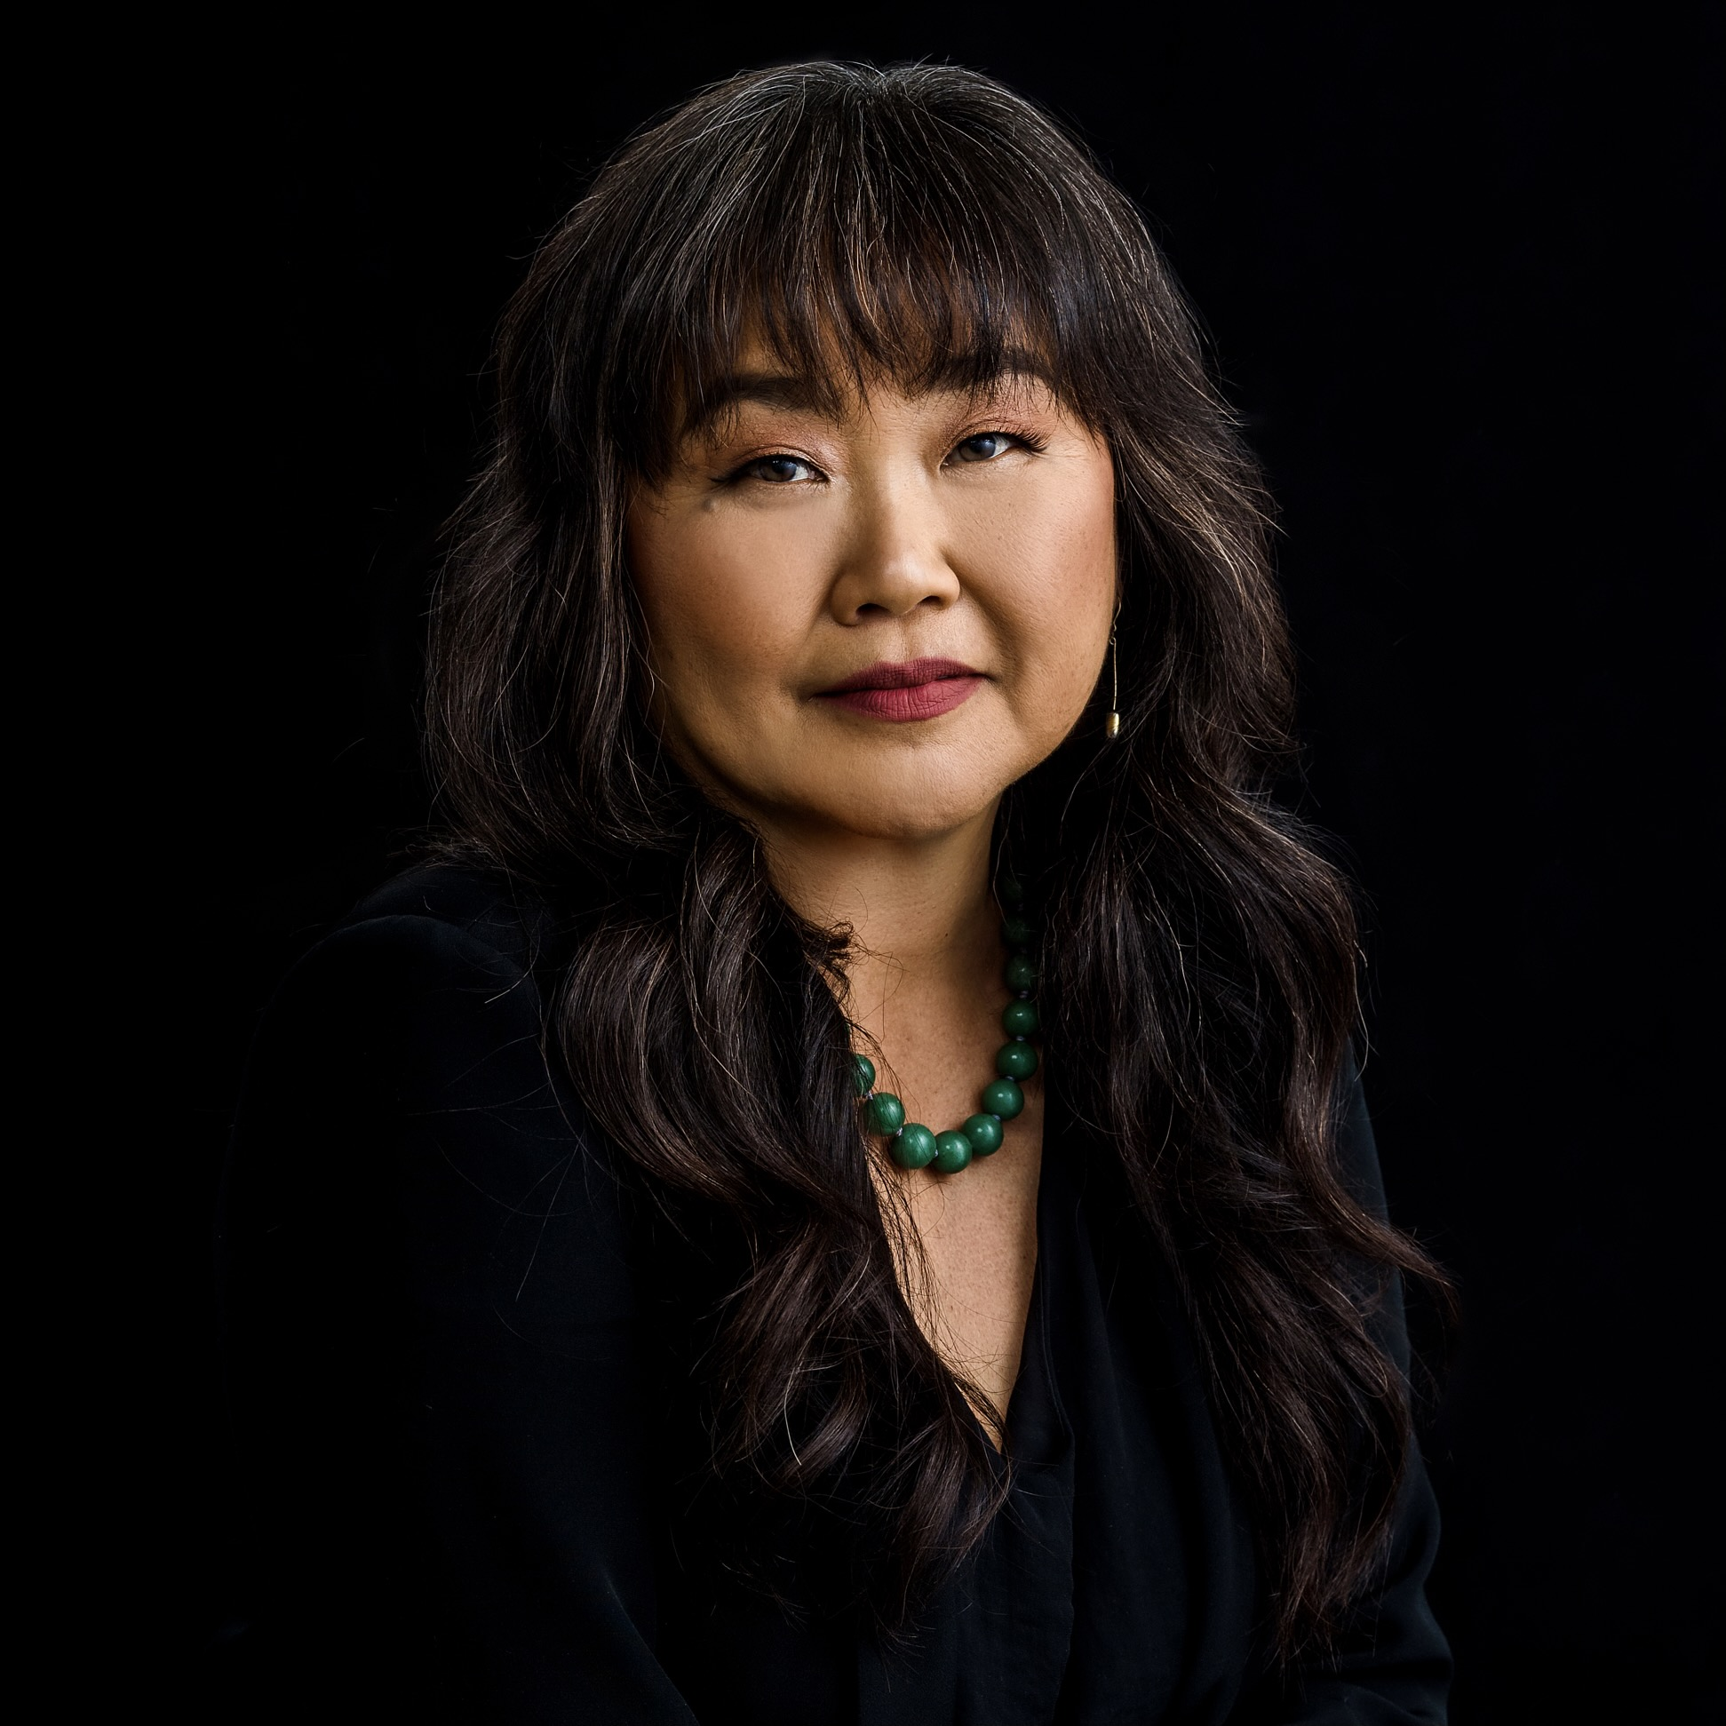
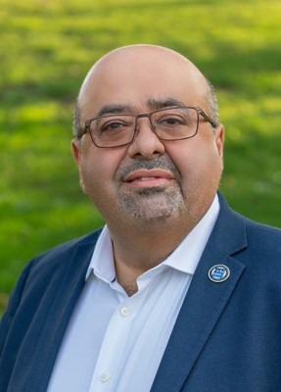
Speaker
Mami Hara, Chief Executive Officer, US Water Alliance
Adel Hagekhalil, General Manager, Metropolitan Water District of Southern California

Slide 9


One Water, One Future: The Need for Transformational Leadership
Mami Hara
Chief Executive Officer
US Water Alliance
May 25, 2022

Slide 10
About us
The US Water Alliance is a national membership organization that
unites diverse interests to advance common-ground solutions to our nation’s most pressing water challenges.
www.uswateralliance.org

Slide 11
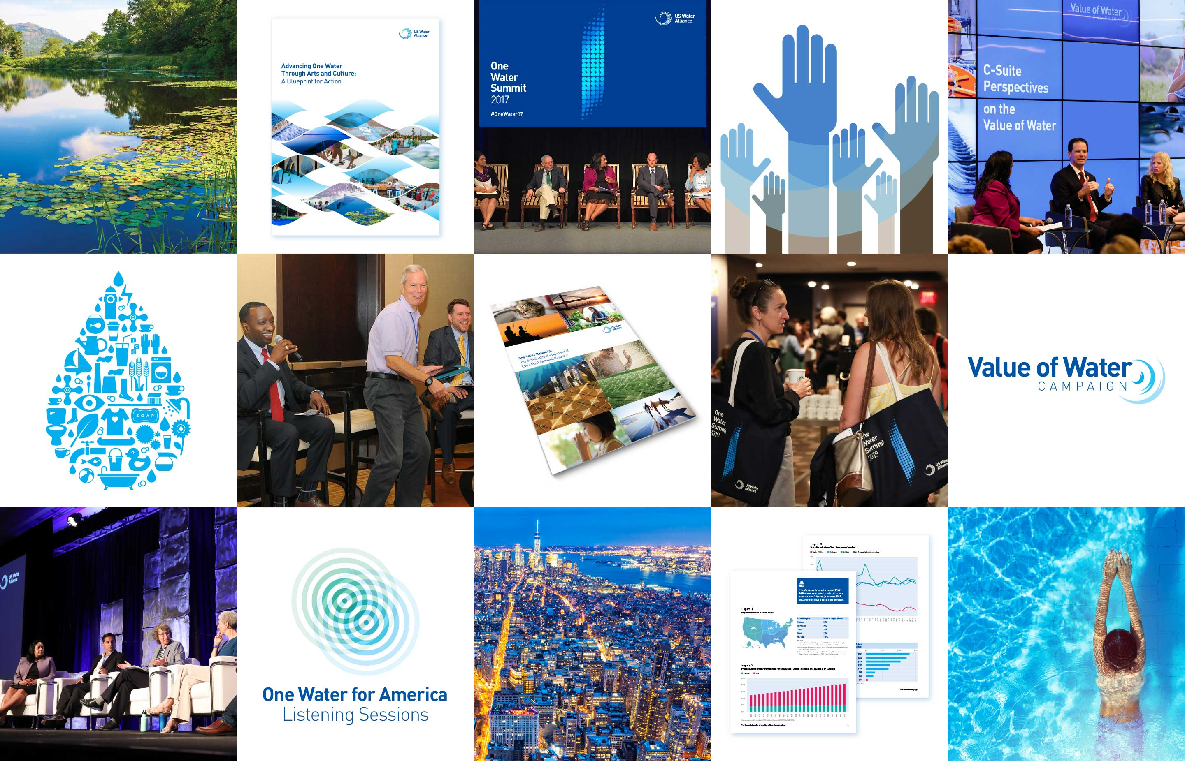
www.uswateralliance.org

Slide 12
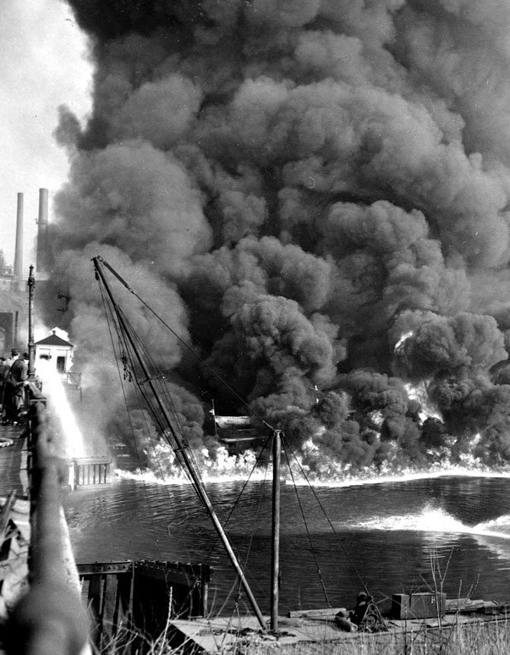
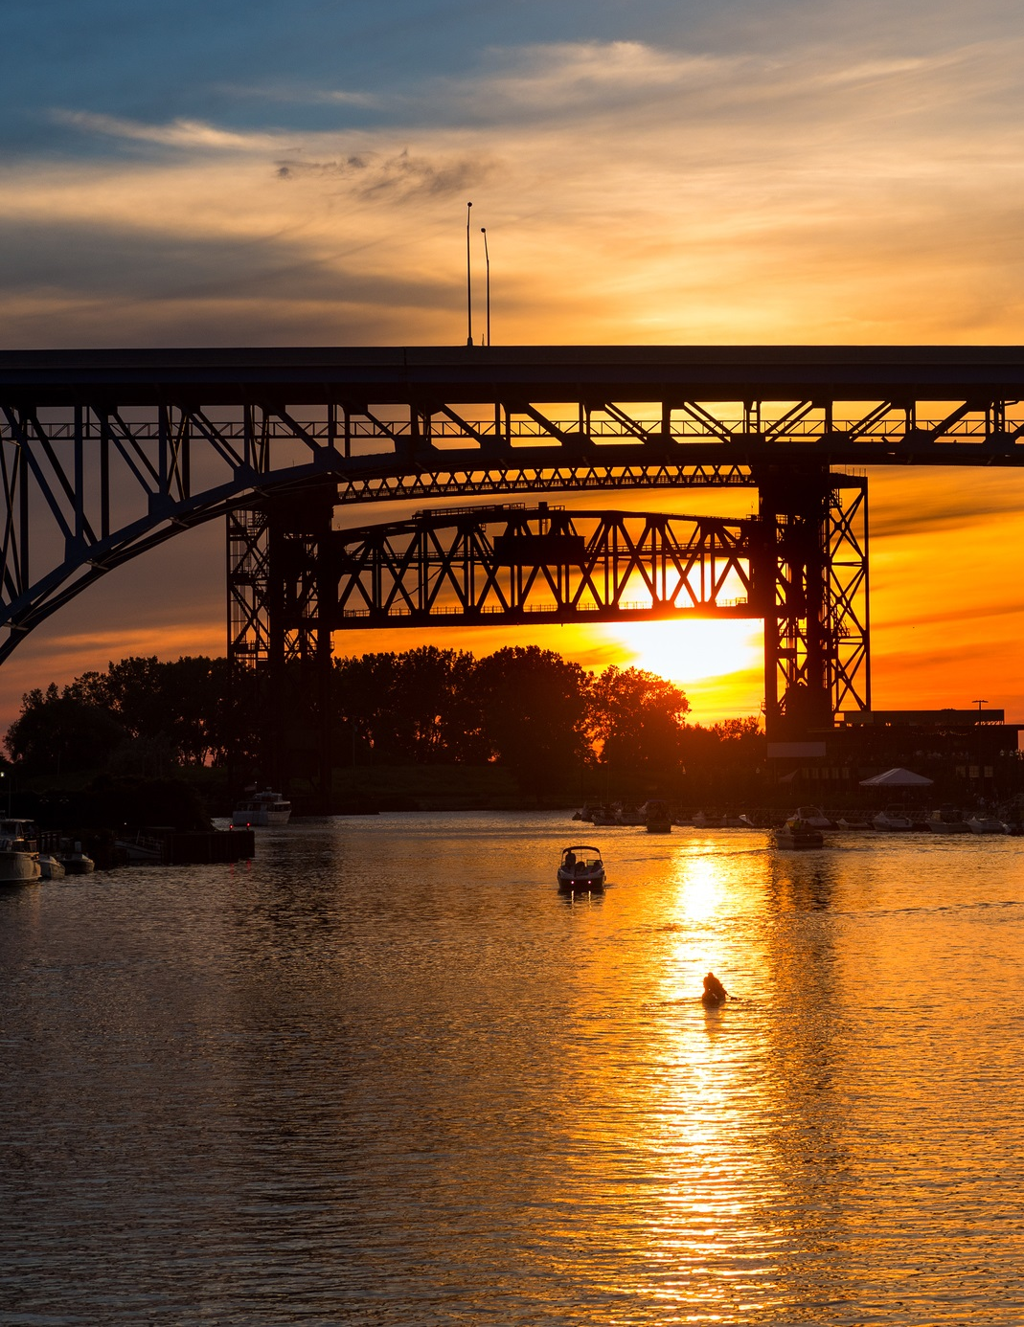

1969
Today
www.uswateralliance.org

Slide 13
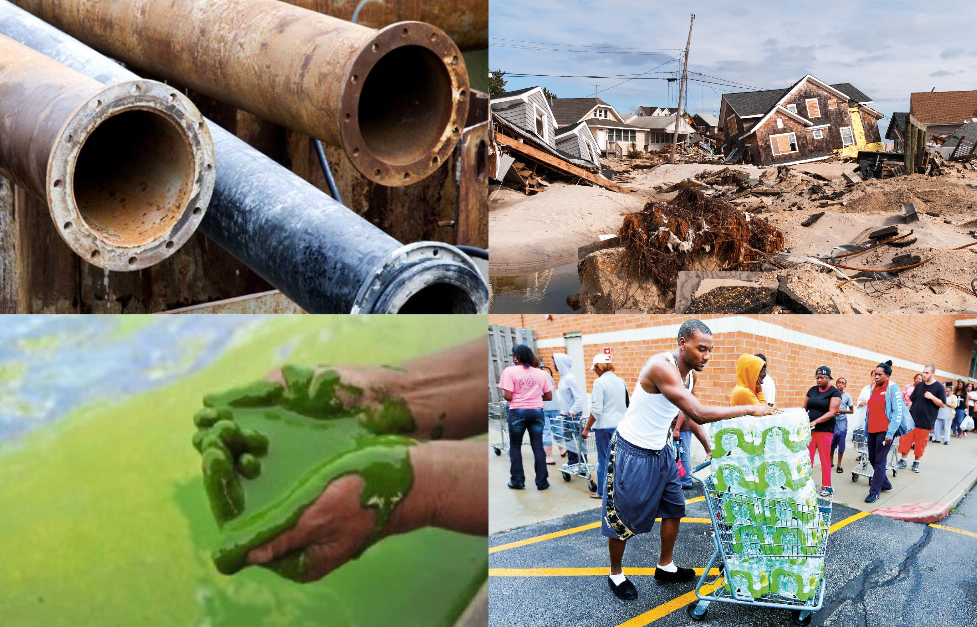
www.uswateralliance.org

Slide 14
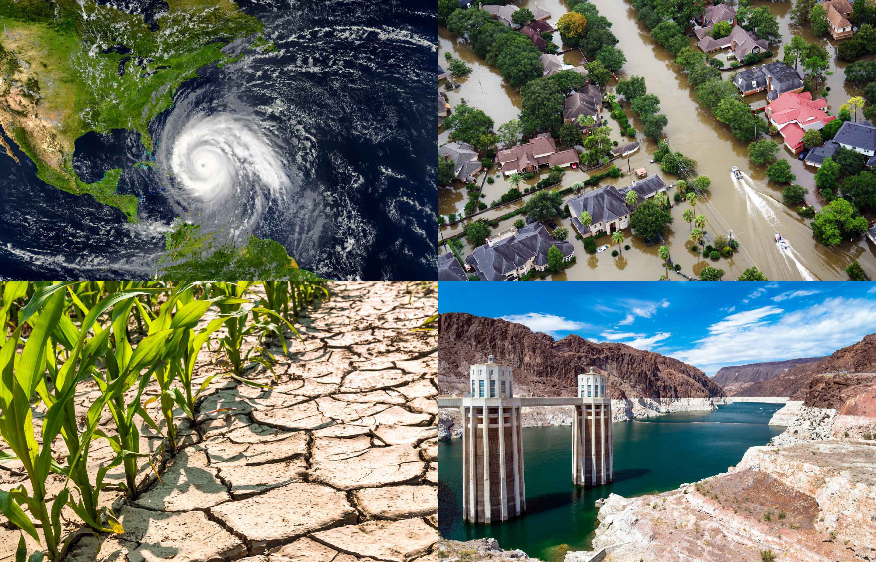
www.uswateralliance.org

Slide 15
We’re at a
pivotal moment.
And business as usual won’t work.
www.uswateralliance.org

Slide 16
The solution is
One Water.
One Water envisions managing all water
in an integrated, inclusive, and sustainable manner to secure a bright, prosperous
future for our children, our communities,
and our country.
www.uswateralliance.org

Slide 17
Hallmarks of One Water:
A mindset that all water has value
A focus on achieving multiple benefits
Watershed scale thinking and action
A systems approach
Right-sized solutions
One Water
One Future
Inclusion and engagement of all
www.uswateralliance.org

Slide 18
What does One Water mean to us?
www.uswateralliance.org

Slide 19
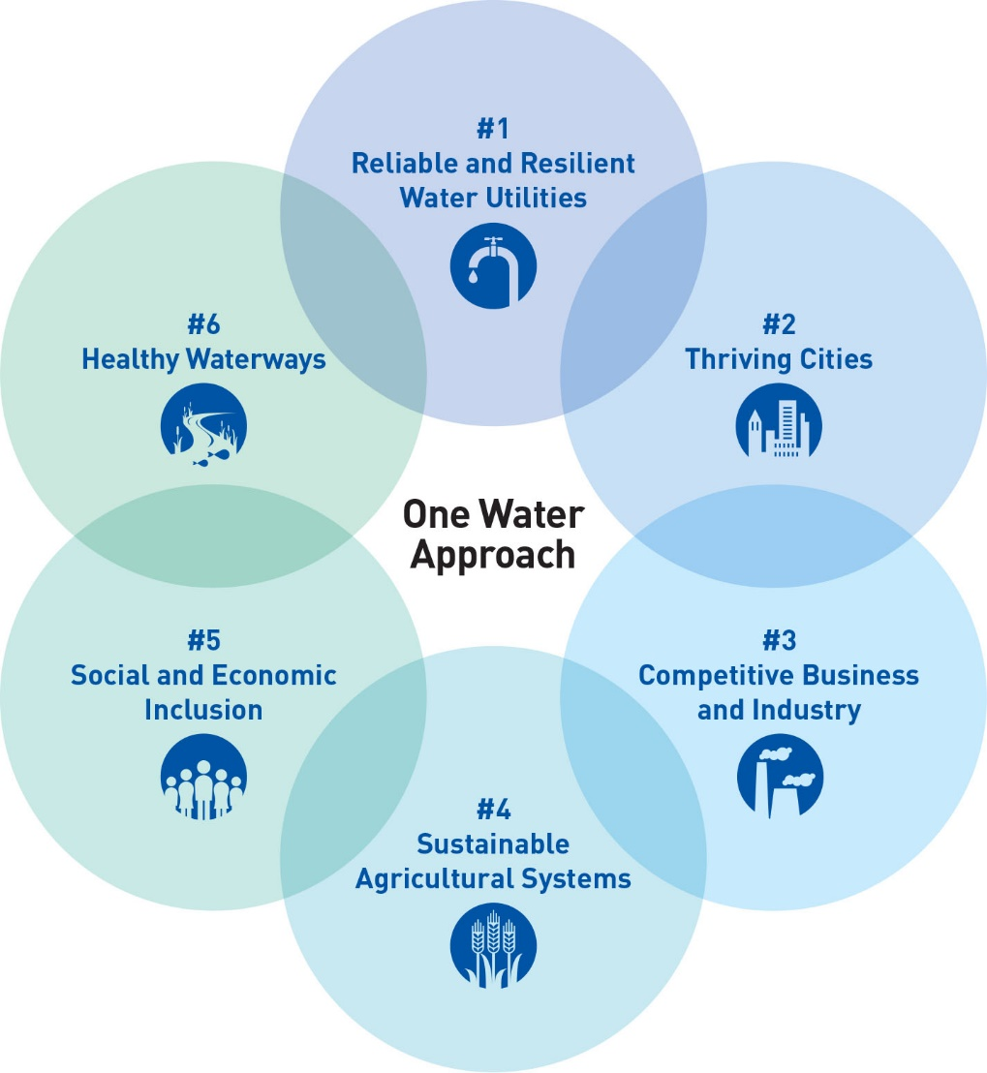
One Water: Six Arenas for Action
www.uswateralliance.org

Slide 20

Arena for Action 1:
Reliable and Resilient Water Utilities
www.uswateralliance.org

Slide 21
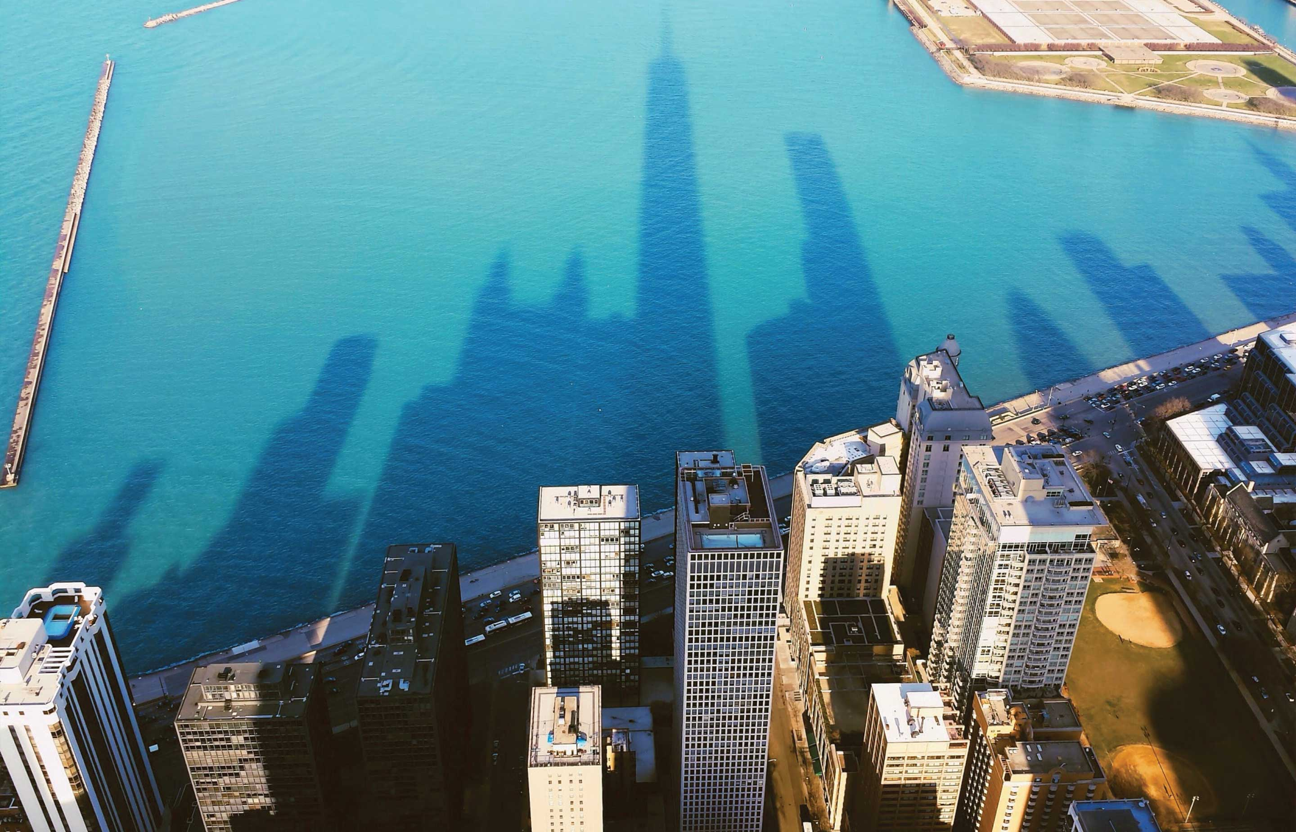

Arena for Action 2:
Thriving Cities
www.uswateralliance.org

Slide 22
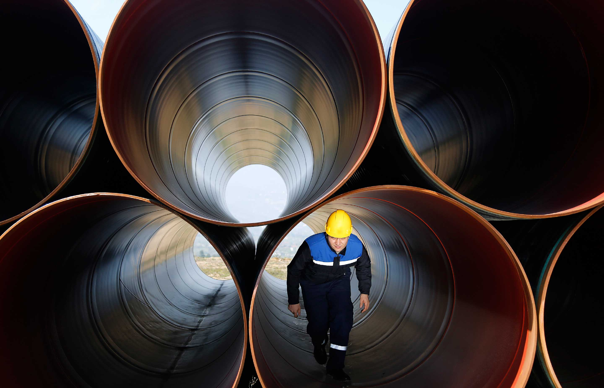

Arena for Action 3:
Competitive Business and Industry
www.uswateralliance.org

Slide 23
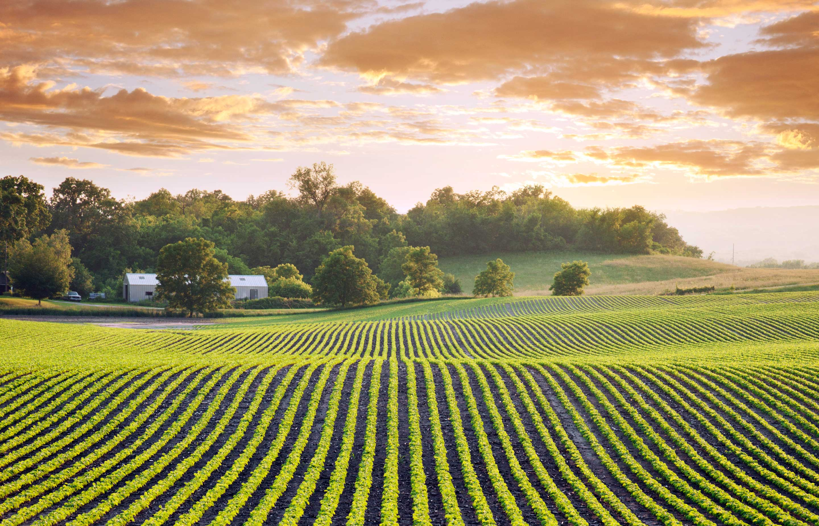

Arena for Action 4:
Sustainable Agricultural Systems
www.uswateralliance.org

Slide 24


Arena for Action 5:
Social and Economic Inclusion
www.uswateralliance.org

Slide 25
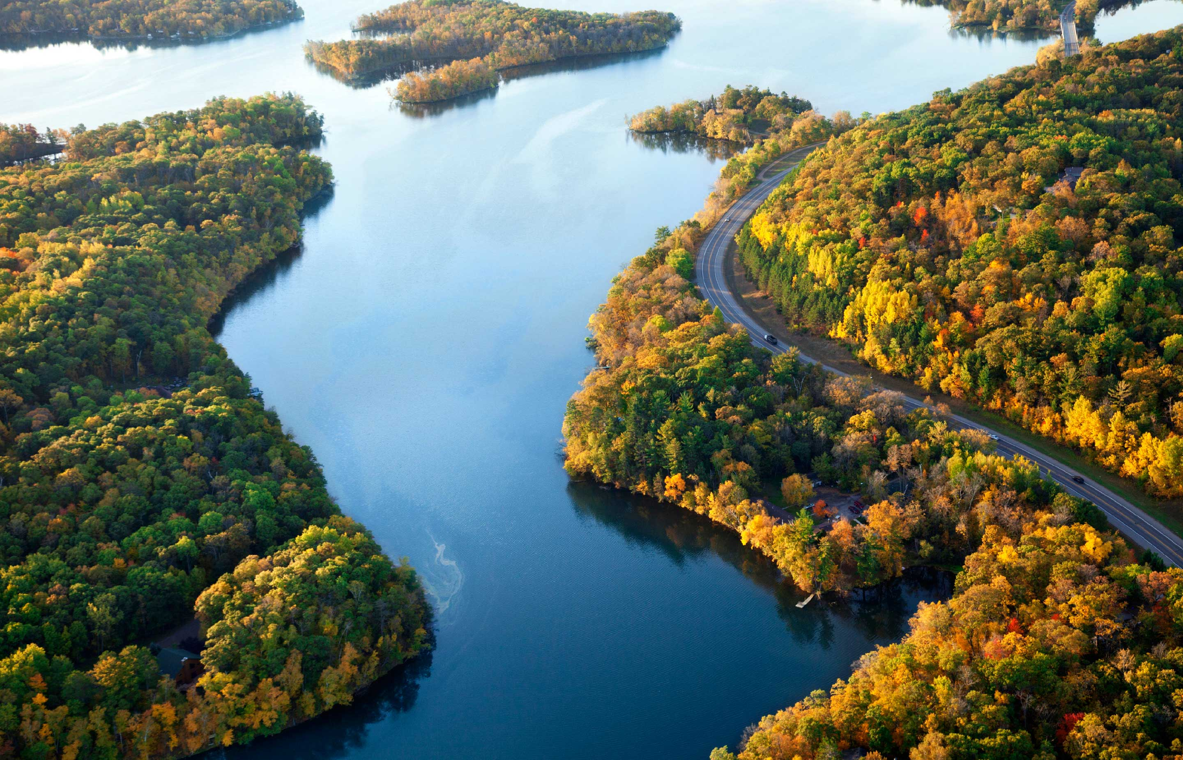

Arena for Action 6:
Healthy Watersheds
www.uswateralliance.org

Slide 26
One Water is the future,
but how do we get there?
Transformational leadership.
www.uswateralliance.org

Slide 27
What does a
transformational leader
look like?
www.uswateralliance.org

Slide 28
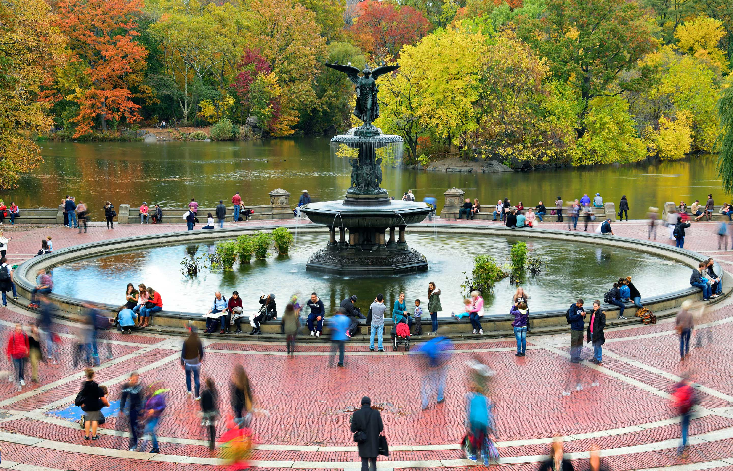
Transformational leaders…
Embrace complexity and don’t shy
away from it.
www.uswateralliance.org

Slide 29
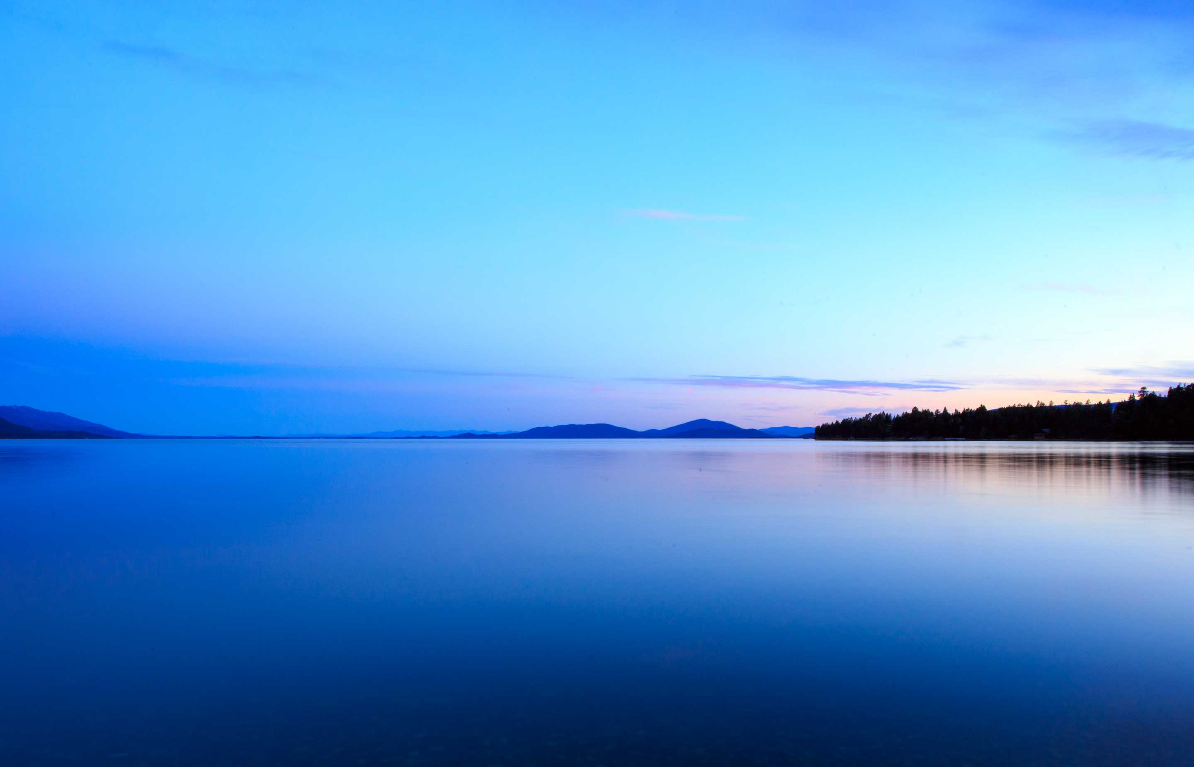
Transformational leaders…
Think differently about the whole,
not just their part.
www.uswateralliance.org

Slide 30
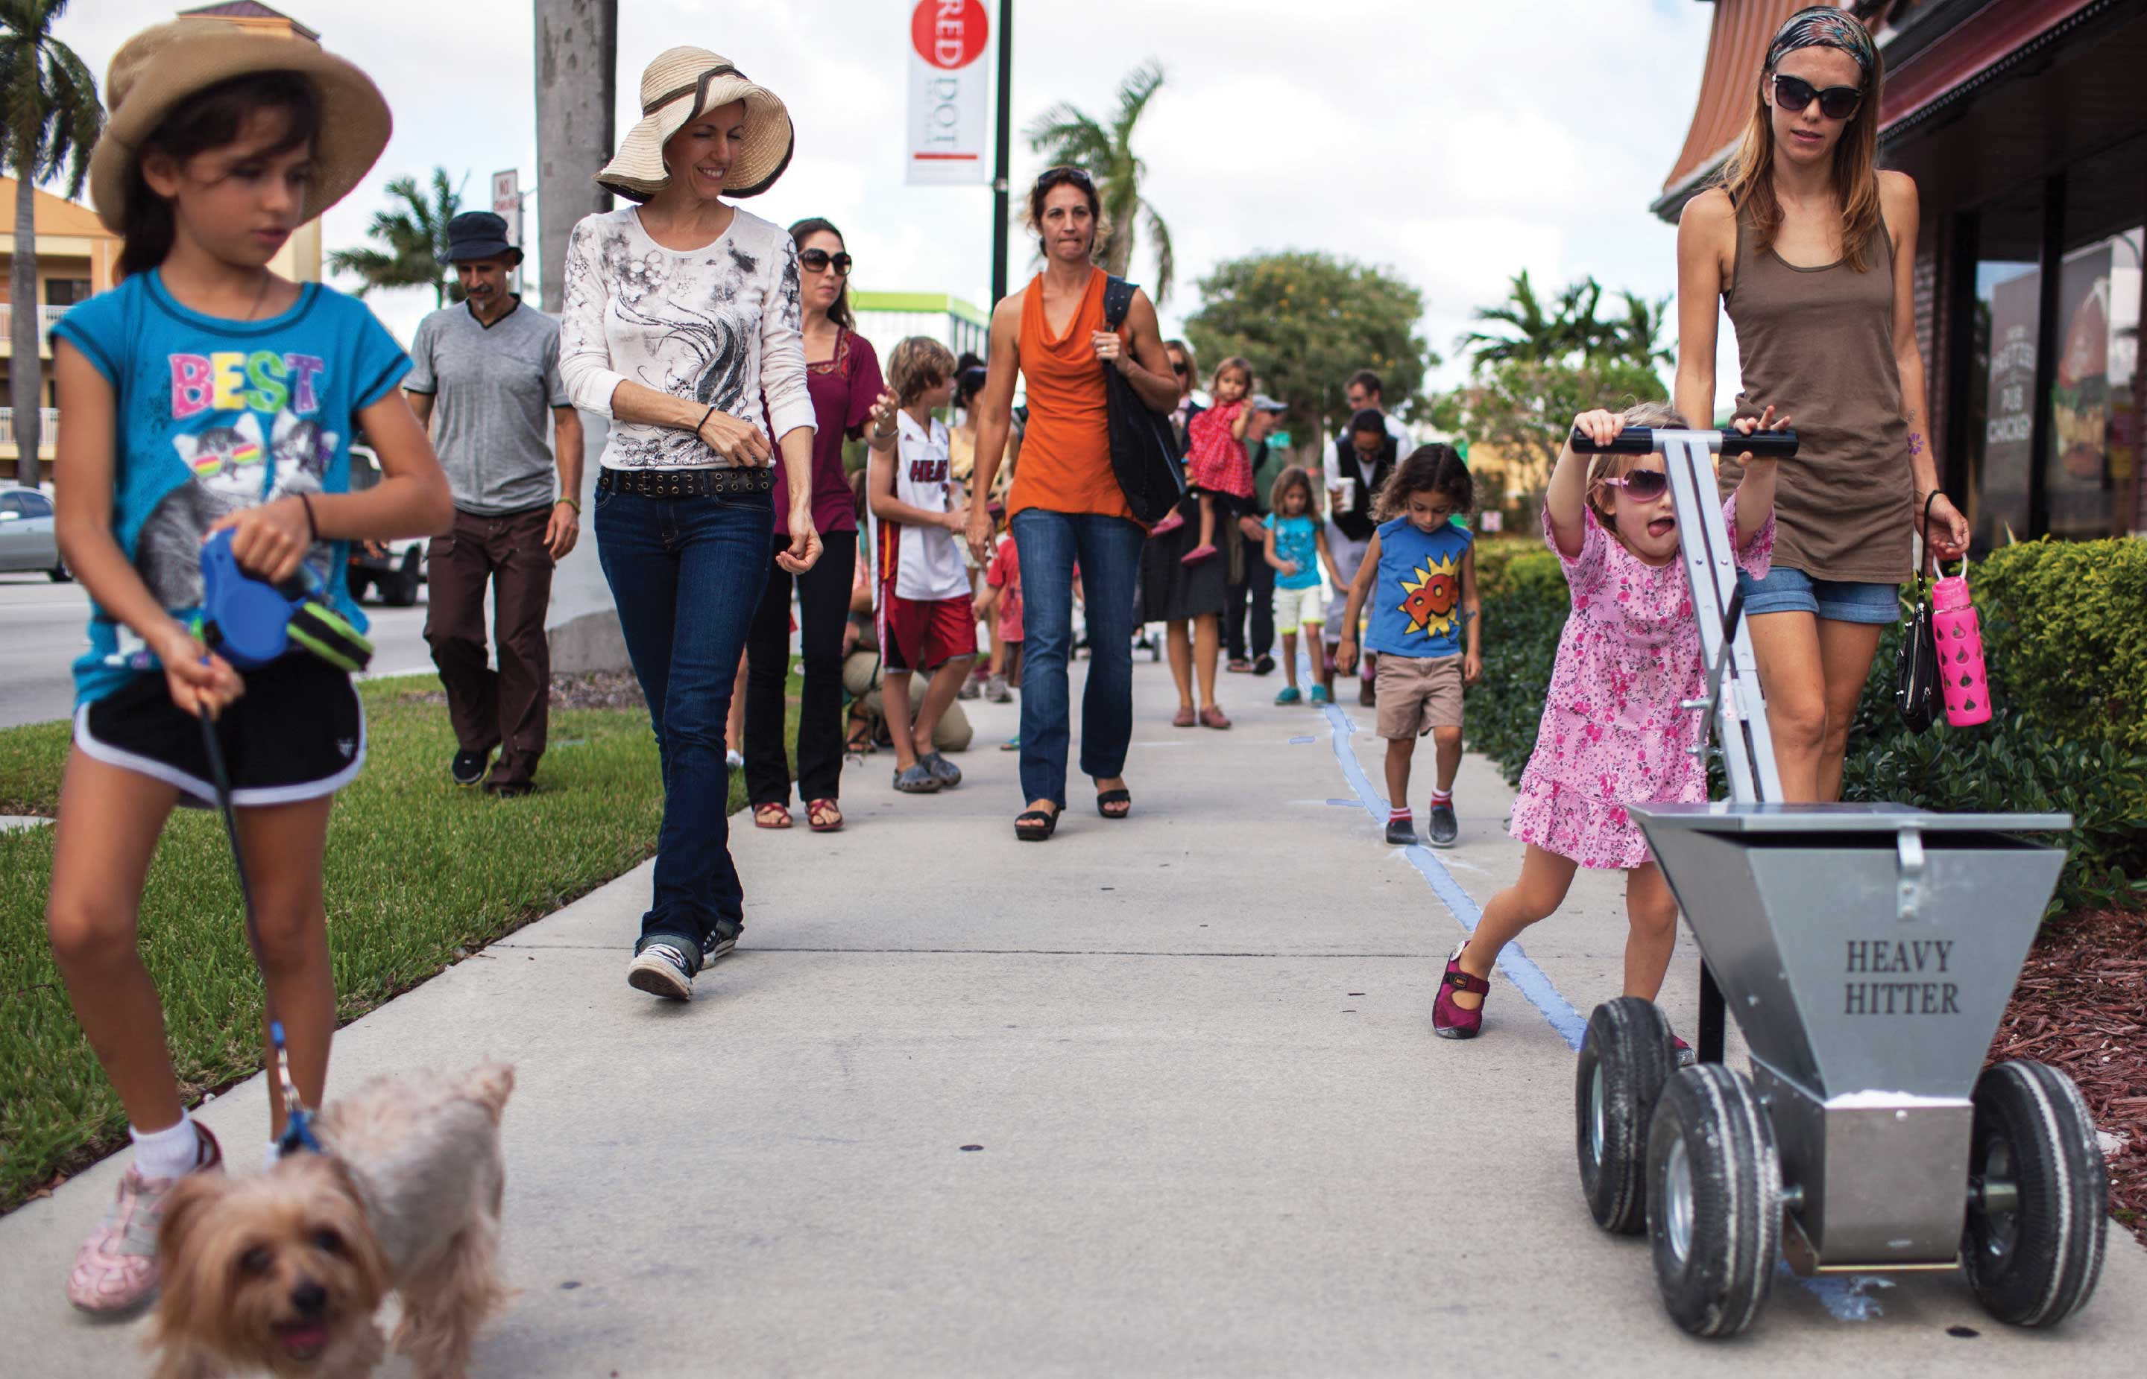
Transformational leaders…
Make water relevant to people’s lived experience.
www.uswateralliance.org

Slide 31
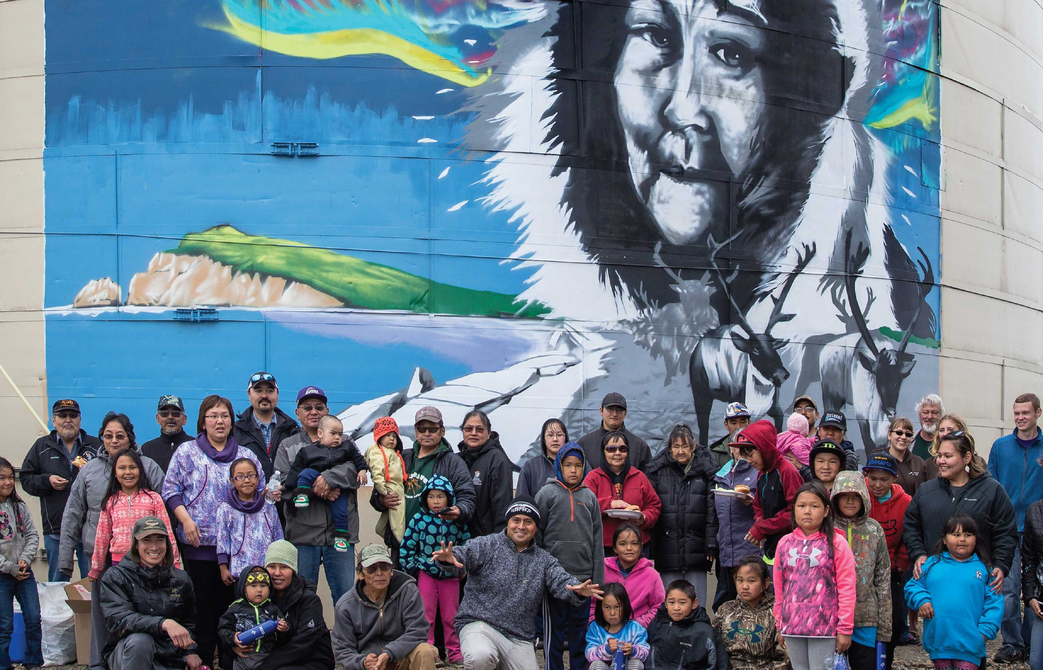
Transformational leaders…
Put equity at the center.
www.uswateralliance.org

Slide 32
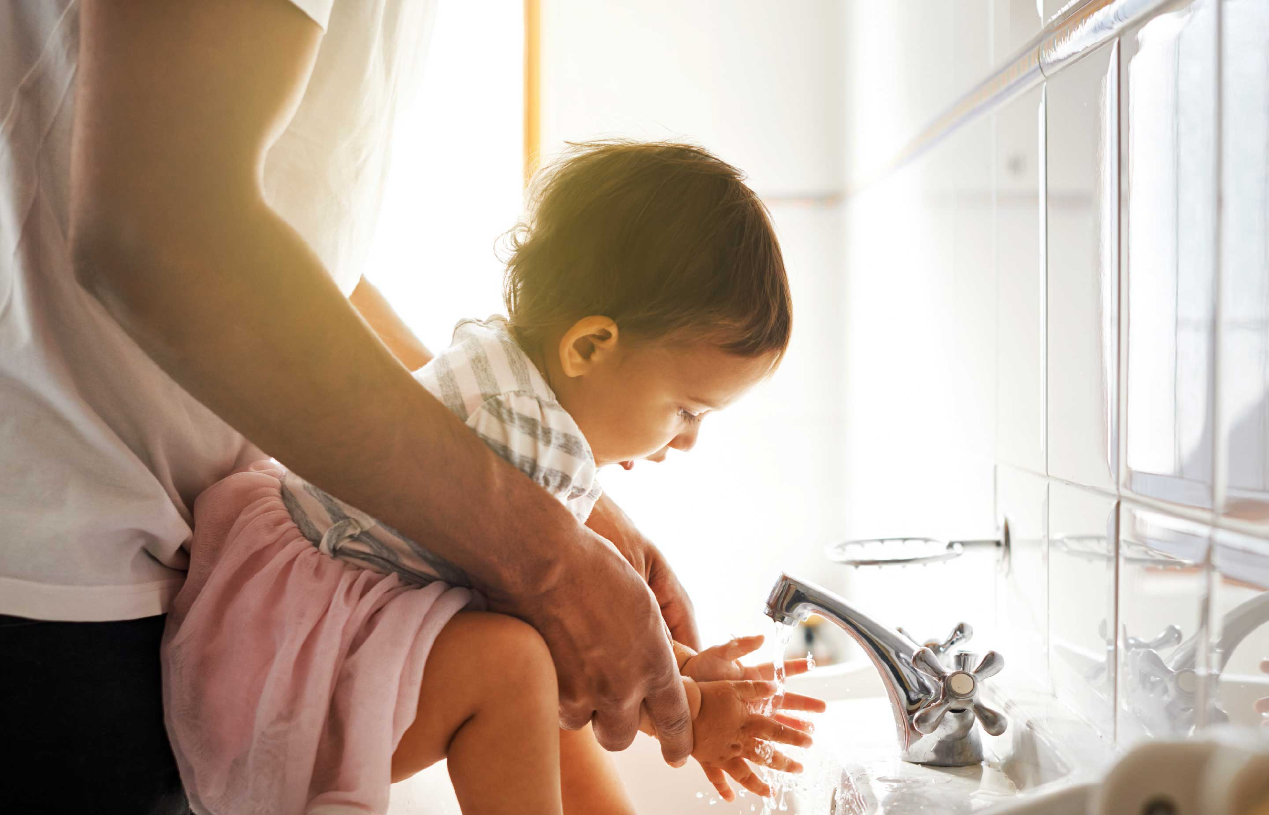
Transformational leaders…
Tell their own water stories and find human connection.
www.uswateralliance.org

Slide 33

www.uswateralliance.org

Slide 34

Save the date!
One Water Summit 2022
September 13-15
Milwaukee, WI
www.uswateralliance.org

Slide 35
Thank you!
For more information:
Mami Hara
mhara@uswateralliance.org
@OneWaterMami
www.uswateralliance.org

Slide 36
Water Supply Update &
Metropolitan’s One Water
Initiative
Southern California Water Dialogue
May 25, 2022

Slide 37

Metropolitan
Water District of Southern California
Northern Sierra
Sacramento &
Feather Rivers
State Water Project
30%
Colorado River
Aqueduct 20%
Upper
Colorado
River Basin
Delta
Regional water wholesaler
19 million people
26 member agencies
Six counties
5,200 square miles
California
Los Angeles
Aqueduct
Colorado
River
Aqueduct
Local Agency Supplies:
50%
Los Angeles Aqueduct
Groundwater
Recycling
Desalination

Slide 38

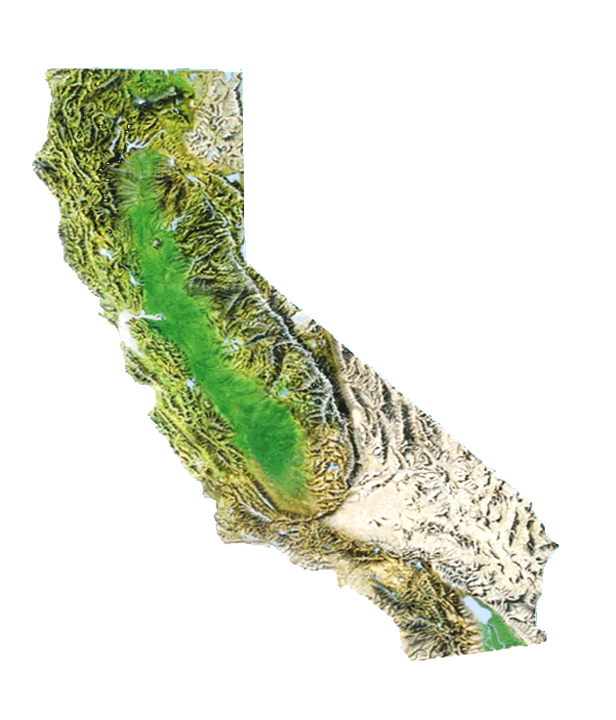
Northern California
Historical Ranking of
Consecutive 3-Year Precipitation
WY 2020-2022 is Currently the Driest 3 Consecutive Years on Record
Inches
2020, 2021, 2022 (as of 5/4)

Slide 39
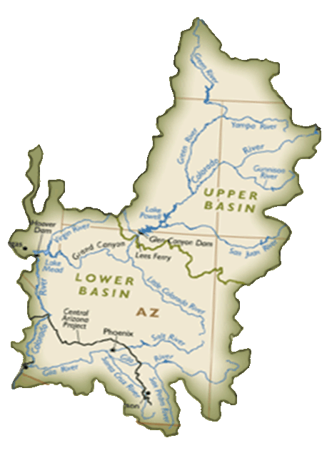

Historical Ranking of
Consecutive 3-Year Inflow to Lake Powell
Upper Colorado River Basin
WY 2020-2022 Projected to be the Second Lowest on Record
Million Acre-Feet
2020, 2021, 2022 Forecast

Slide 40


The West Now Faces a Megadrought that Started in 2000
Northern California
Lake Powell
Sacramento River Runoff (Million Acre Feet)
Average
Since 1906
Inflow Into Lake Powell (Million Acre Feet)
Average
Since 1963
~20 million AF
~60 million AF
Central Valley Project + State Water Project
Combined Storage Capacity
Upper Basin + Lower Basin
Combined Storage Capacity

Slide 41
California is Getting Warmer
California Average Temperature
Degree Fahrenheit
Warming trend since the turn of the century
Normal

Slide 42
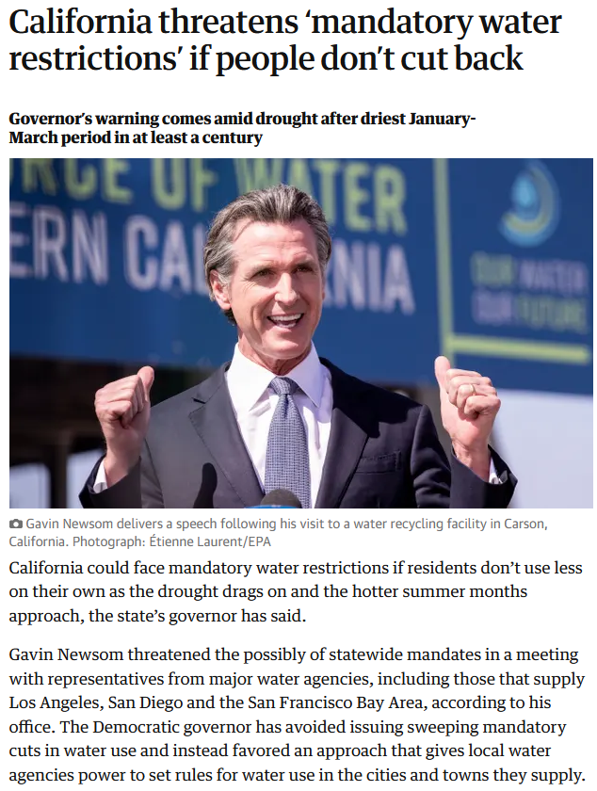
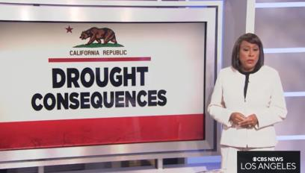
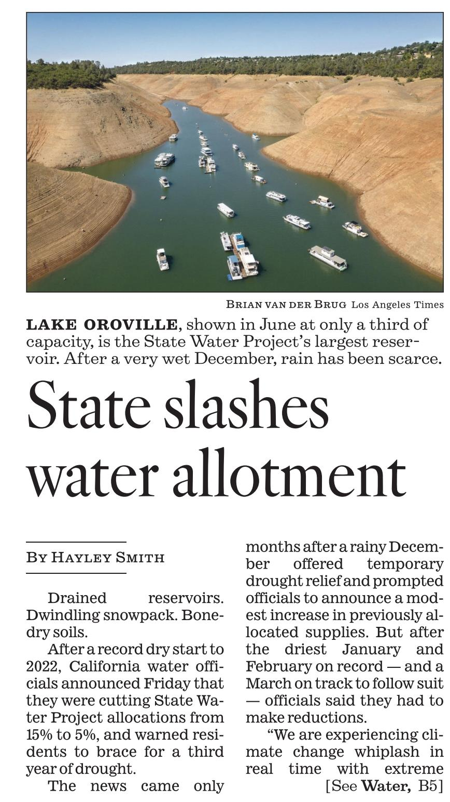
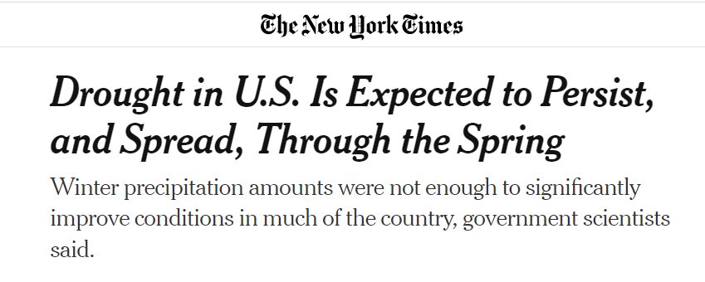
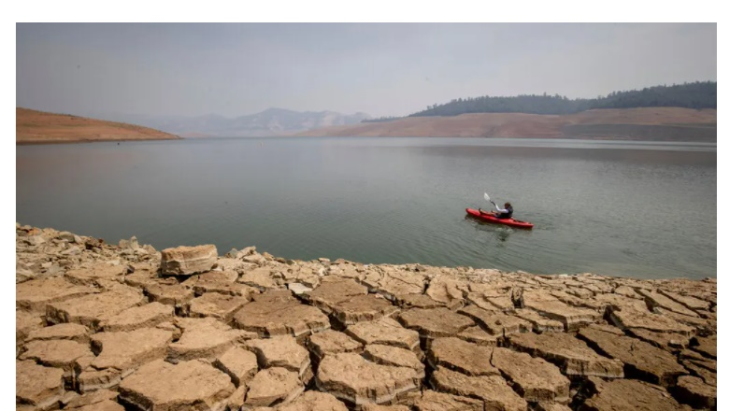
Drought Impacts State Water Project
Most reservoirs are below historical average for this time of year.
First time in the history of SWP with two consecutive years (2021 and 2022) with a 5% allocation.

Slide 43
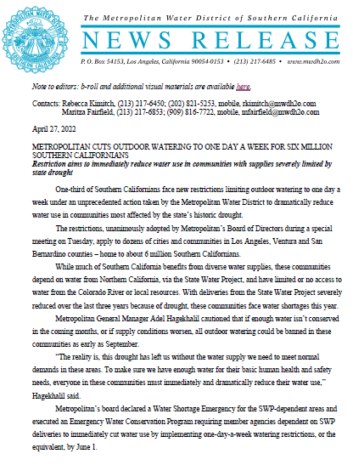
Metropolitan Board Limits Water for SWP Dependent Area
On April 27, 2022 Metropolitan Board of Directors imposed limits to the agencies within the SWP Dependent Area.
Agencies may choose to impose maximum of one-day a week irrigation or follow volumetric limits.

Slide 44
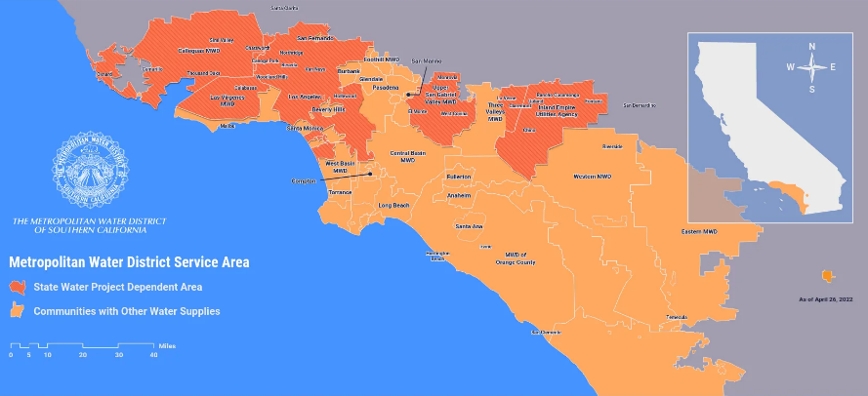
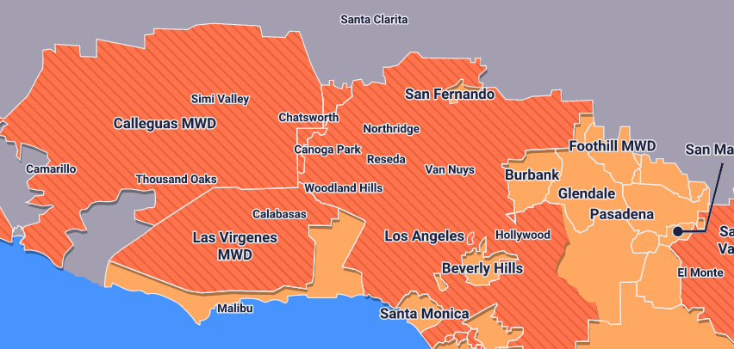
Insufficient Supplies for SWP Dependent Area
The SWP Dependent Area has ~6 million people
and receives limited Colorado River water.

Slide 45
Framework of Emergency Water Conservation Program
Two Paths for Compliance
Water Shortage Emergency
Path 1
Path 2
1-day watering
Volumetric
Limits
(HH&S +
Remaining
MWD
Supplies)
Jun. 1
0-day watering
Sept. 1
(If needed)
Dec. 1
(If needed)

Slide 46
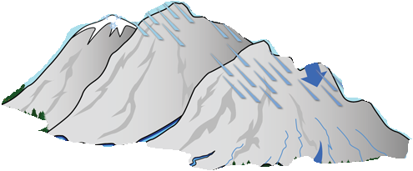
SWP Dependent Area
Demands
Must
Drop
2022 SWP Dependent Area Monthly Supply/Demand
Water Shortage Emergency
Projected
Demands must drop
(as of Apr 6, 2022)

Slide 47
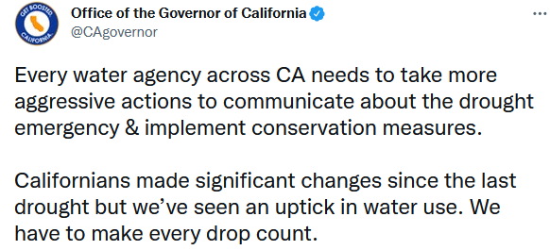
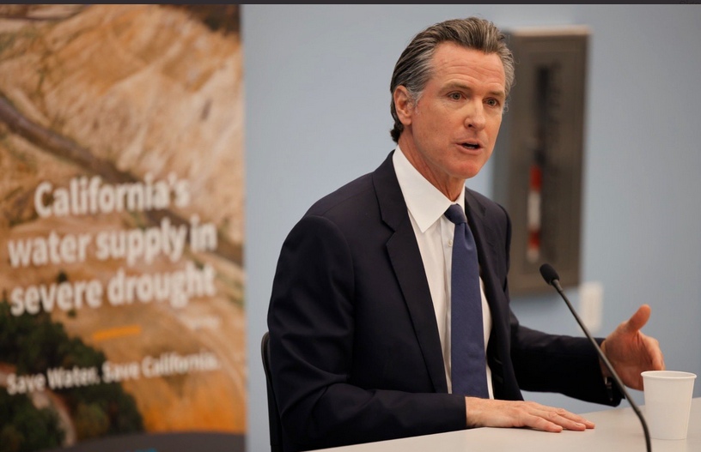
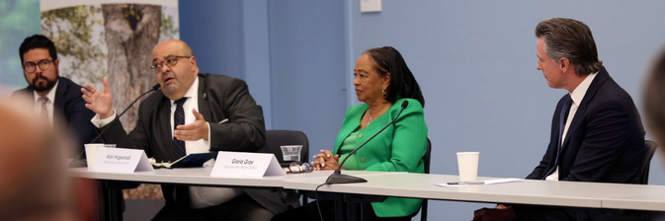
State Board Drought Emergency Regulation
Executive Order N-7-22 directed the State Water Board to consider adopting an emergency regulation.
On May 24, 2022 the State Water Board approved a regulation requiring urban water supplies to implement Level 2 demand reduction actions.

Slide 48
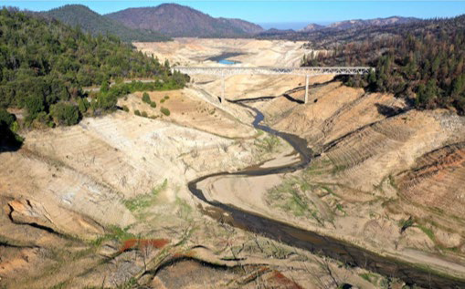
Long Term Solutions Are Needed
Lake Oroville
Lake Mead
This is more than drought. This is climate change

Slide 49
Planning for the future requires a One Water Approach

Slide 50
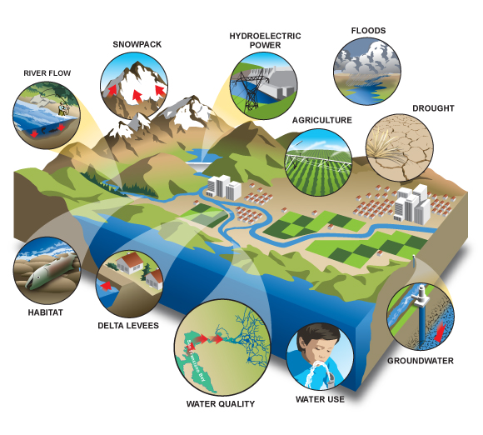

Water Resources Are Connected
WILDFIRE
Source: CDWR Fact Sheet

Slide 51
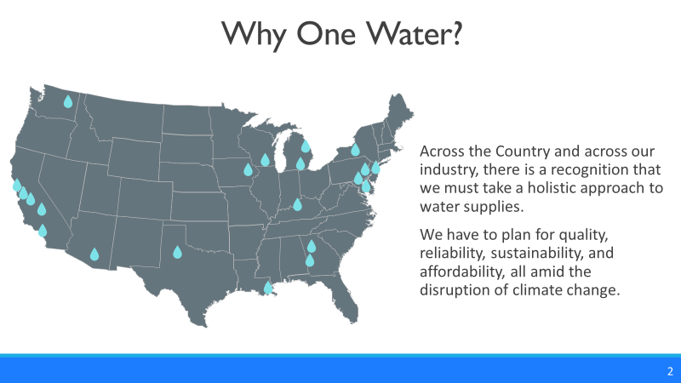
Metropolitan’s One Water
Initiative

Slide 52
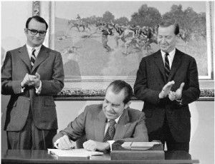
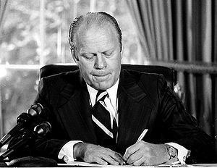
Two
Waters
Reigned for a Century
Two Waters Established in Legislation…
Clean Water Act
(1972)
Safe Drinking Water Act (1974)

Slide 53
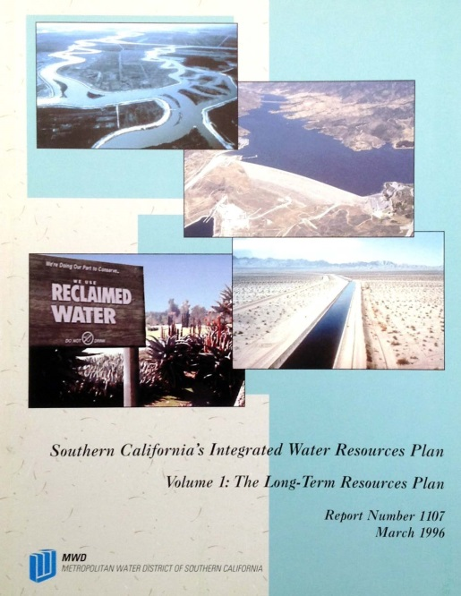
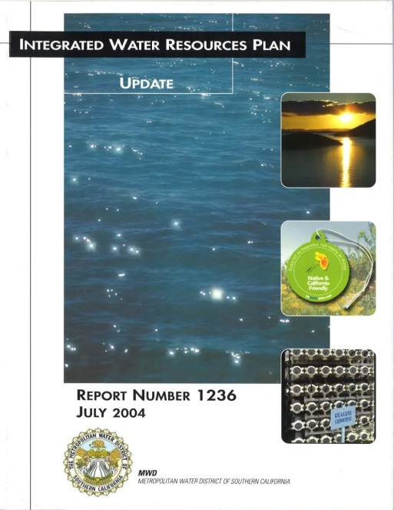
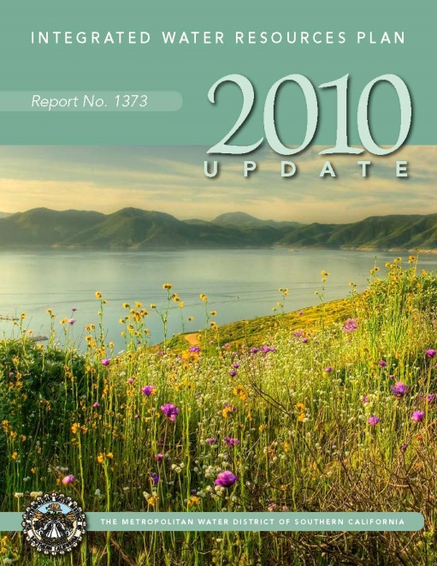
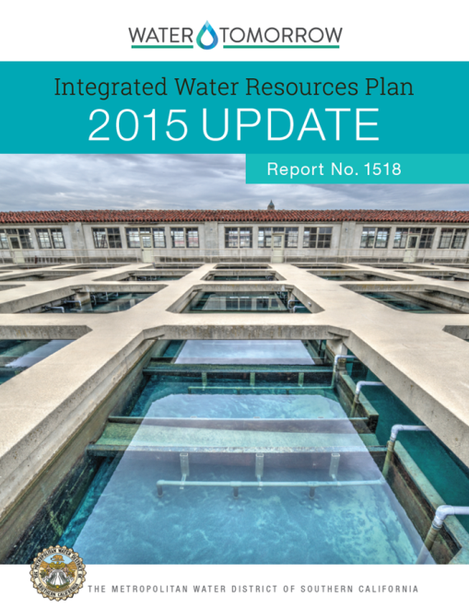
Integrating One Water into Planning
Integrated Water Resources Plan
  Builds climate uncertainty into planning approach
One Water recognizes the value and integration of all water resources

Slide 54


Definition
“An integrated planning and implementation approach to managing finite water resources for long-term resilience and reliability, meeting both community and ecosystem needs.”
The mission of the Metropolitan Water District of Southern California is to provide its service area with adequate and reliable supplies of high-quality water to meet present and future needs in an environmentally and economically responsible way.
Paulson et al. (2017)

Slide 55
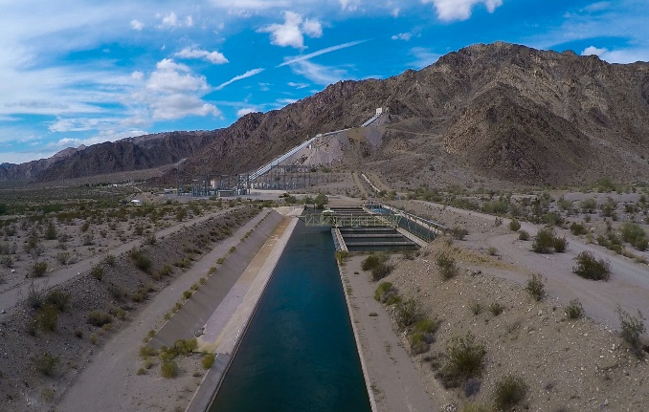
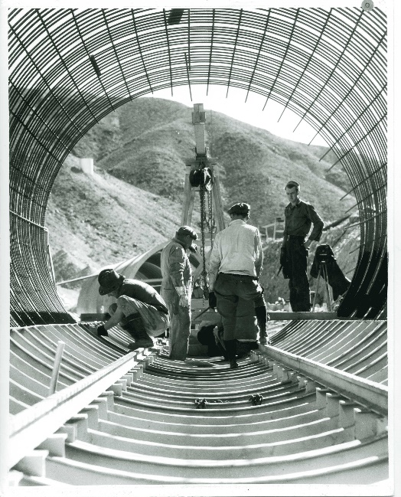
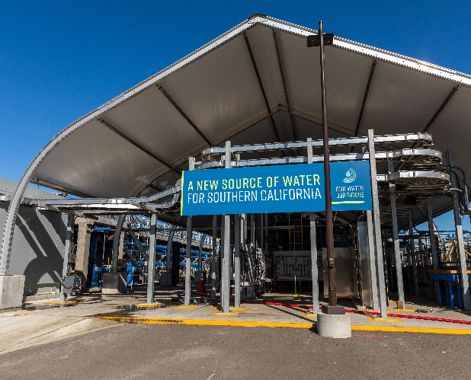
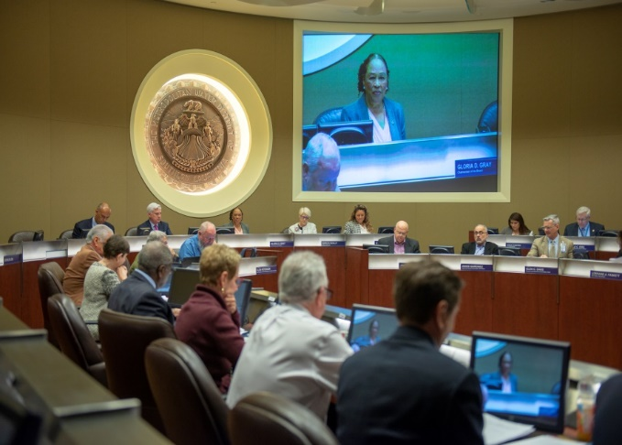
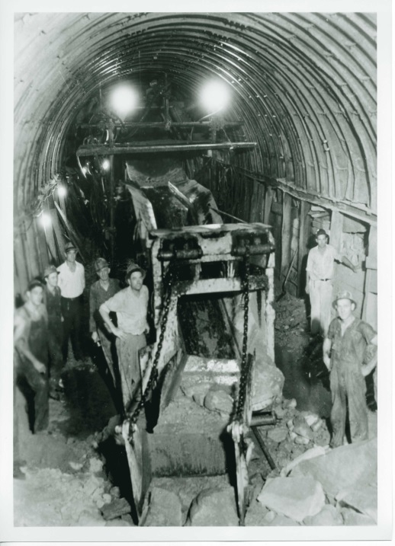
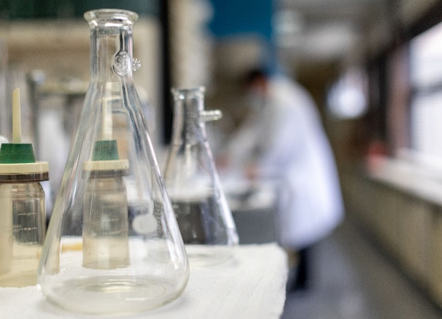
Metropolitan is positioned to lead One Water
Regional Integrated System
New Local Supplies
Flexible System
Cooperative Structure
Cutting EdgeTechnology

Slide 56
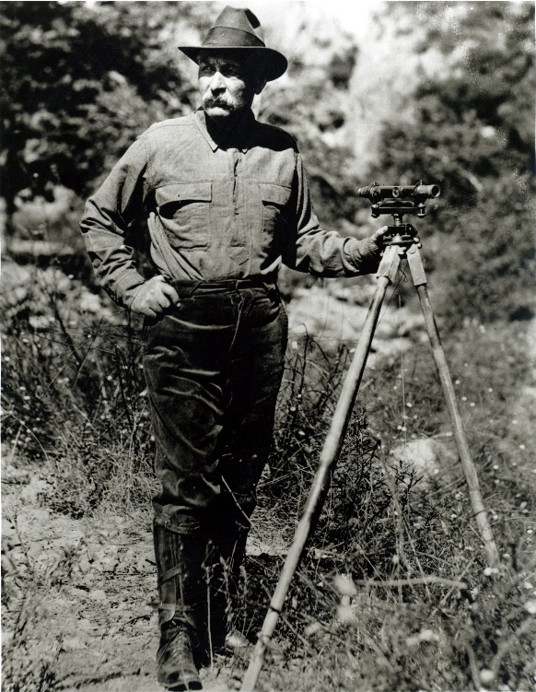




Building the 4th Aqueduct

Slide 57


Regional
Recycled Water
Program

Slide 58


Expanding
Storage
Antelope Valley East Kern
Water Bank

Slide 59


Capturing
Stormwater
West Basin MWD (City of Culver City)
Western MWD (Victoria Recharge Basin)
5/9/2022
59

Slide 60











Making the Most of
Every Drop
Outreach
Turf Removal
Device Rebates
Education
Codes & Regs

Slide 61





                Integration
                Innovation
                Inclusion

Slide 62


Slide 63

Question and Answer

Slide 64
How to Ask a Question
Click “Q&A” on the bottom of your screen

Slide 65
You can upvote by clicking
“thumbs up” icon
Type in question
and then click send

Slide 66
Next
Southern California Water Dialogue Webinar
Wednesday, June 22, 2022
12:00 – 1:30 pm
Your feedback on today’s meeting is important to us. For the next ten minutes, you can use the Zoom Chat feature to send us any comments.
Socalwaterdialogue.org
Notes:
any

